Slide 1
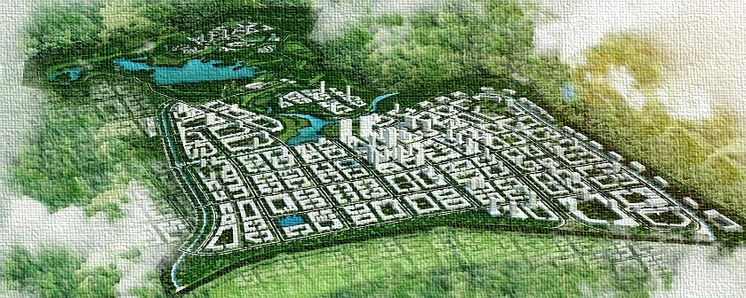
DA NANG HI-TECH PARK
AND INDUSTRIAL ZONES AUTHORITY
INNOVATION HUB – SUSTAINABLE DEVELOPMENT

Slide 2
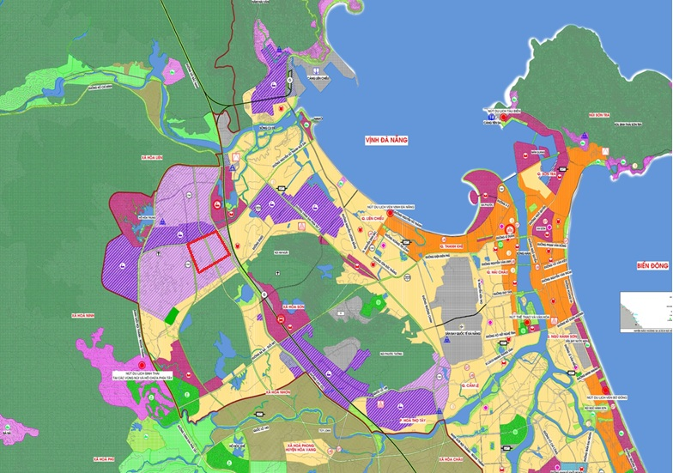
OVERVIEW ABOUT DA NANG HI-TECH PARK, INFORMATION TECHNOLOGY PARK AND INDUSTRIAL ZONES
1. HI-TECH PARK: 1,128.4HA
2
2. LIEN CHIEU IZ: 289.35HA
3. HOA KHANH IZ: 394HA
4. EXPANDED HOA KHANH IZ: 132.6HA
5
5. SEAFOOD SERVICE AREA: 50.63HA
1
3
6. DA NANG IZ: 50.1HA
4
6
7. HOA CAM – PHASE 1 IZ: 136HA
8
8. IT PARK: 131HA
7

Slide 3
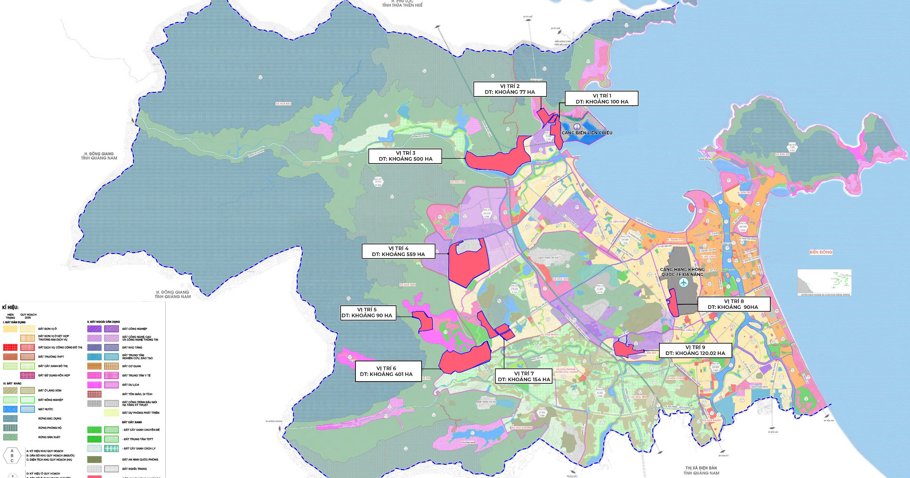
OVERVIEW ABOUT DA NANG FREE TRADE ZONE
PROJECTED LOCATION FOR FUNCTIONAL ZONES IN DANANG FREE TRADE ZONE (According to Paper No. 64/TTr-UBND dated March 16, 2025 issued by the People's Committee of Da Nang)

Slide 4
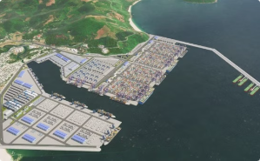
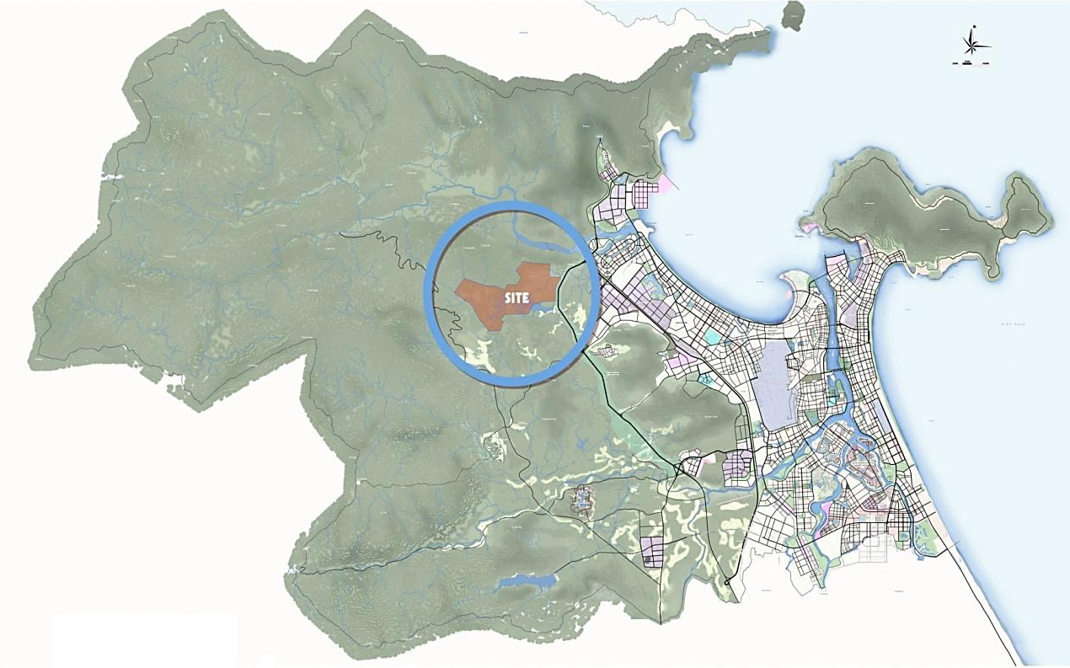
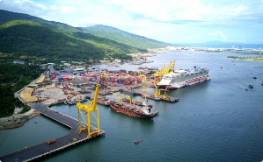
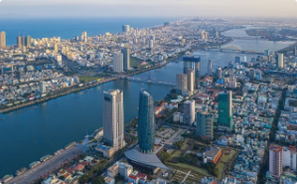
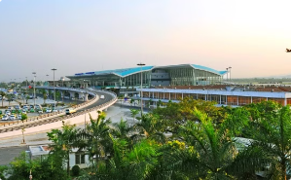
A. DA NANG HI-TECH PARK
5km to Lien Chieu port
I. LOCATION:
25km to Tien Sa port
22km to Administrative Center
17km to Da Nang International Airport

Slide 5
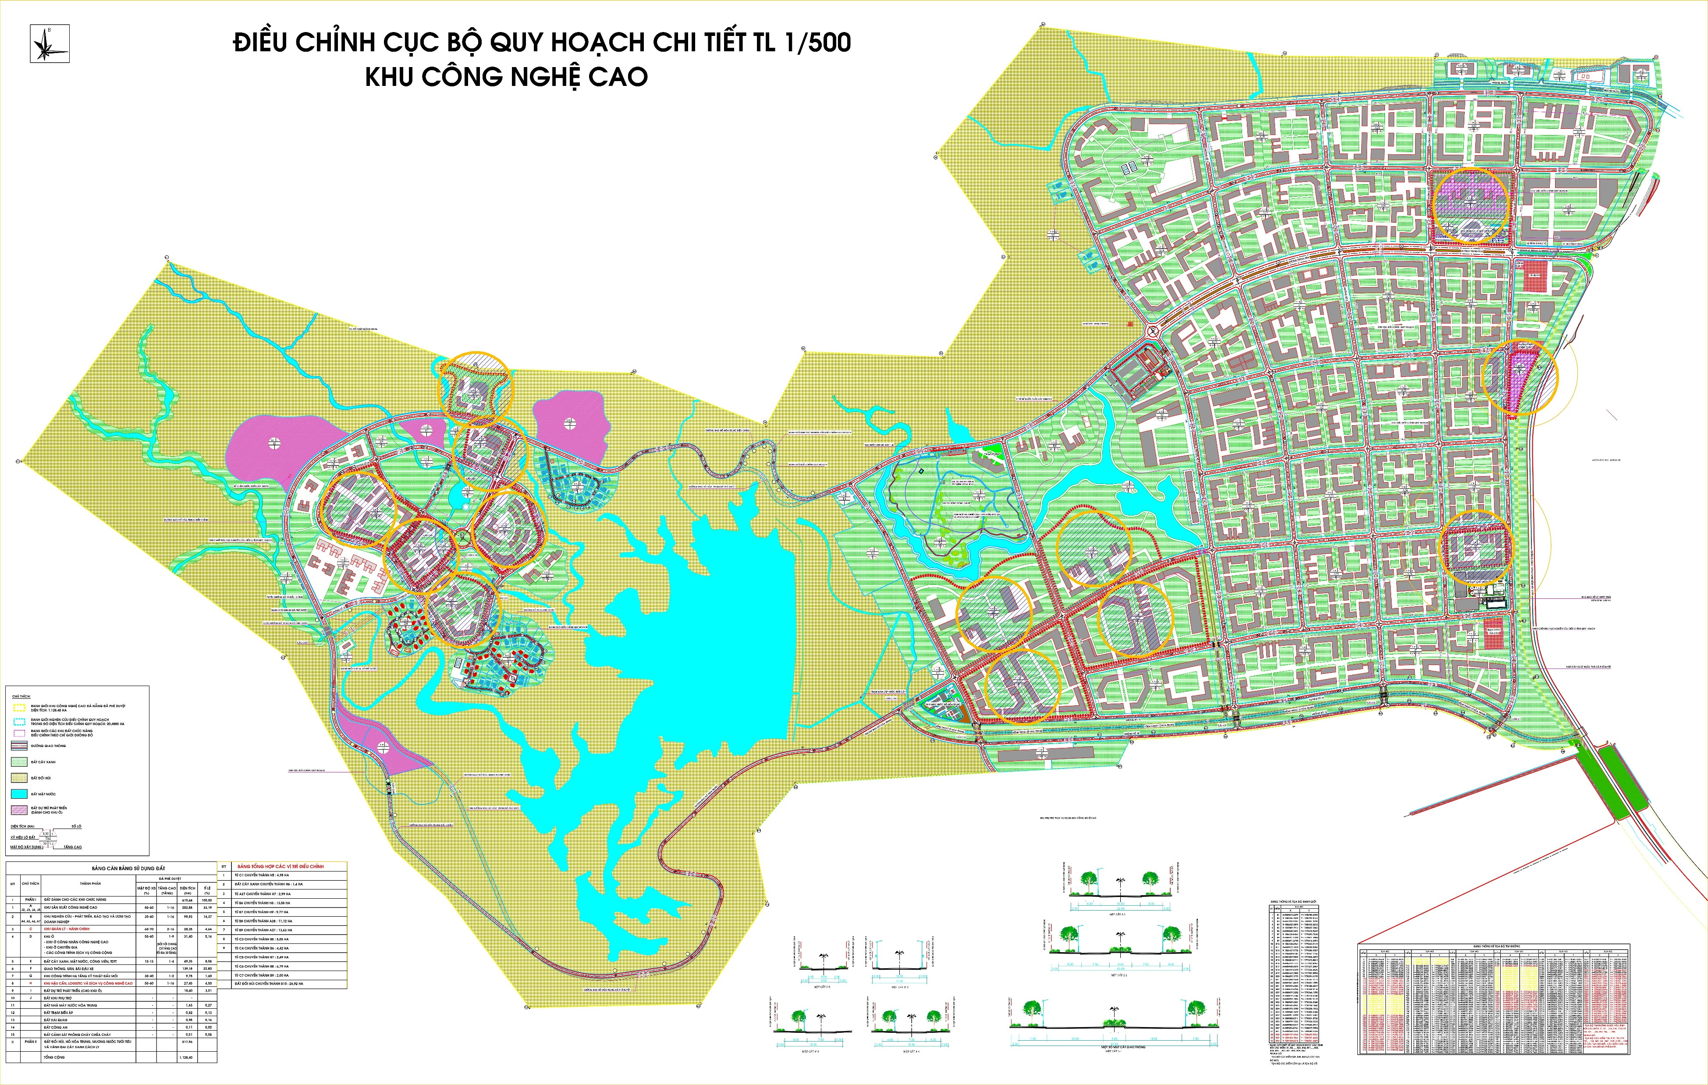
II. HI-TECH PARK MASTER PLAN
Hi-tech logistics and services area
27.45 ha
TOTAL AREA: 1,128.40 ha
Hi-tech Production area
290.66ha
Hi-tech Production area
31.40 ha
Administrative area
10.18 ha
Technical Infrastructure area
9.75 ha
R&D, Training and Incubation area
48.42 ha

Slide 6
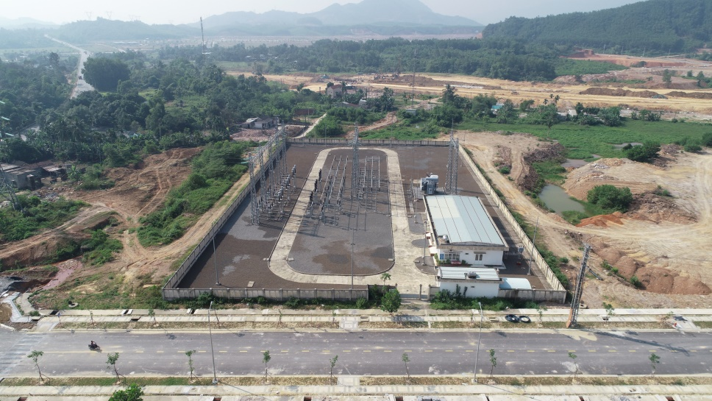
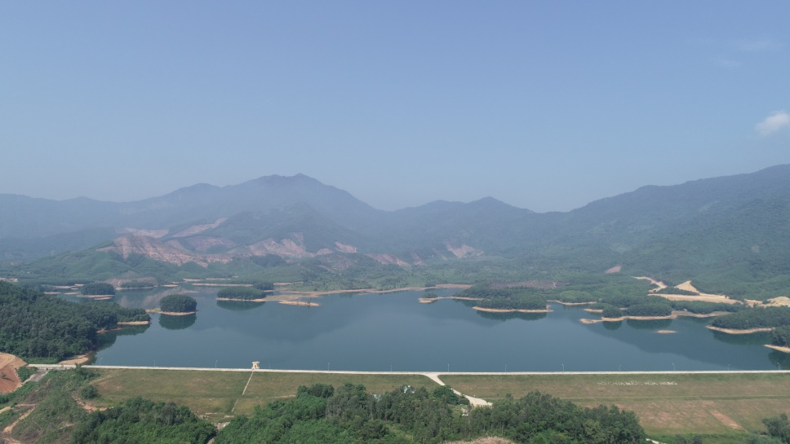
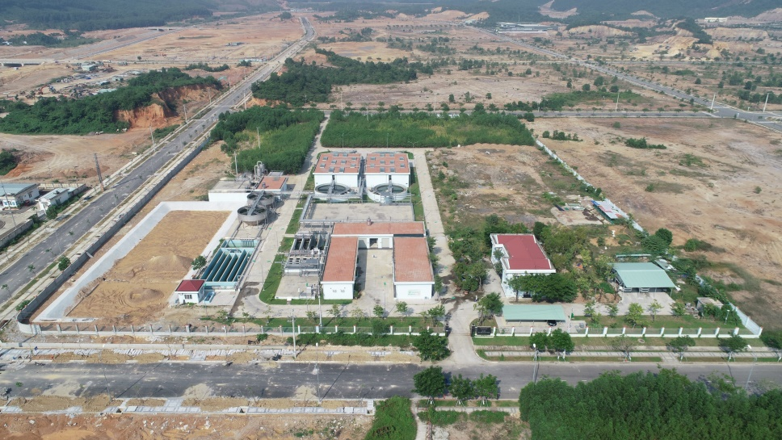
III. TECHNICAL INFRASTRUCTURE
POWER SUPPLY: Power station 110kV
TELECOMMUNICATION
● High quality transmission line
● Smooth connection and information security
WATER SUPPLY: Hoa Trung water plant
20.000m³/ day.night
WASTEWATER TREATMENT PLANT
18.000m³/ day.night

Slide 7
IV. PRIORITISED INVESMENT FIELDS
99
PRIORITISED
HI-TECH
1. Microelectronics, mechatronics
and opto-electronics
2. Biotech
3. ICT
107
ENCOURAGED
HI-TECH PRODUCTS
4. Automation,
Precision mechanics
5. New energies, nano
tech, new materials
6. Tech applied for petrochemistry and other special industries

Slide 8
V. INVESTMENT INCENTIVE POLICY
Land rent exemption
Land rent incentive:
19 years exemption
15 years exemption
Corporate Income Tax Incentive:
Năm | 1 | 2 | 3 | 4 | 5 | 6 | 7 | 8 | 9 | 10 | 11 | 12 | 13 | 14 | 15 | 16 | 17 | 18 | 19 | 20
 |  |  | Tax rate 10%
 |  |  |  |  | Tax Exemption
 |  |  |  |  |  |  |  |  | 50% Reduction
 |  | First year generating revenue (to count tax) |  |  |  |  |  |  |  | First year generating taxable income (time for exemption and reduction)
Preferential Tax rate of 10% in 15 years*
Tax Exemption in the first 4 years
50% Tax Reduction in the next 9 years
* Project over 3000 billion VND (equivalent to 132 million USD): Preferential Tax rate of 10% in 30 years and 100% exemption of compensation and land site clearance fee 30 năm

Slide 9
VI. INVESTMENT PROJECT IN DA NANG HI-TECH PARK
31
$1.23
PROJECTS
BILLION USD
DSEZA has issued:
Total capital
31 investment projects with a total capital of 1.23 BILLION USD, including 17 domestic projects with a total registered investment capital of 9,190.73 billion VND (356.3 million USD) and 14 FDI projects with a total registered investment capital of 880.5 million USD
Typical projects: ICT Vina Medical Equipment Manufacturing Project (DENTIUM Company Limited); Electronic Equipment Manufacturing Project (Foxlink Electronics Company Limited); Manufacturing, Processing and Assembling Aircraft Components Project (UAC Company); KP Vina Aviation Components Factory (KP Vina Company) etc

Slide 10
B. DA NANG FREE TRADE ZONE
PROJECTED LOCATION FOR FUNCTIONAL ZONES IN DANANG FREE TRADE ZONE (According to Paper No. 64/TTr-UBND dated March 16, 2025 issued by the People's Committee of Da Nang)

Slide 11
I. FUNCTIONAL ZONES IN DA NANG FREE TRADE ZONE
First Free Trade Zone in Vietnam
Connected to Lien Chieu deep-sea seaport
Projected planning area: around 2.091 ha
FREE TRADE ZONE
Production - Logistics zone
Digital Technology Industry and Innovation zone
Trade – Service zone
Other functional zones
1. Production – Logistics zone: manufacturing industries applying modern, advanced technology, following the green industrial model and creating high added value; multimodal logistics services and related accompanying support in a modern direction, applying digital technology and automation, creating high added value
2. Trade – Service zone: including high-quality, international-class commercial and service activities: duty-free business, cross-border e-commerce, trade promotion, etc.; tourism services (entertainment, betting, etc.); high-quality education and health services; ancillary services and warehousing.
3. Digital Technology Industry and Innovation zone: digital technology clusters (information technology and new technologies, artificial intelligence, big data, cloud computing, internet of things, blockchain, etc.); cross-border e-commerce; trade finance services and financial technology (fintech)....
4. Other functional zone: related support services (providing office space for rent, housing, accommodation services, restaurants, sports services, entertainment services, exhibitions, etc.).

Slide 12
II. INVESTMENT INCENTIVE POLICY
1
Duration of investment project operation up to
70 years
2
Foreign investors are not required to have an investment project or undergo the procedures for issuance or adjustment of the Investment Registration Certificate prior to establishing the economic organizations
3
Exemption and reduction on land rent for projects in construction and operation of infrastructure functional zones are similar to regulations applicable to economic zones
.
4
Corporate income tax incentives:
Tax rate of 10% in 15 years
Exemption in the first 4 years, 50% reduction in the next 9 years
5
Tax incentives for goods and services traded within functional zones of FTZ; between other domestic areas and foreign entities with functional zones of FTZ are similar to regulations applicable to non-tariff zones in economic zones
6
Incentives on tax, land, credit, accounting are similar to incentives for projects in economic zones
Priority customs treatment

Slide 13
III. STRATEGIC INVESTOR
Charter capital
> 1,000 billion VND (40 million USD)
INVESTMENT INCENTIVES FOR STRATEGIC INVESTORS
Having experience in investing in a similar project with total investment capital
>2,000 billion VND (80 millio﻿n USD)
03
Being entitled to priority treatment for custom and tax procedures for exported and imported goods of the project
Included in deductible expenses to determine taxable income for R&D activities equivalent to 150% of the actual cost of this activity when calculating corporate income tax.
04

Slide 14
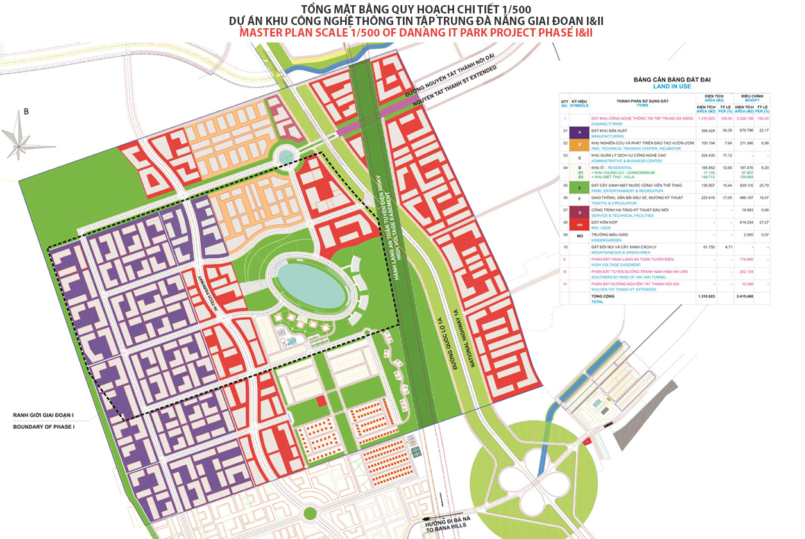
C. IT PARK
Location: Hoa Lien Commune, Hoa Vang District
Project size: 131 ha (Phase 1)
Total investment: 47 million USD (Phase 1)
Vision: DITP will become one of the best IT development communities in Asia in Da Nang City following the US Silicon Valley model.
Investment attraction situation: 05 domestic projects with registered capital of 2,719 billion dong (116 million USD)

Slide 15
I. OVERVIEW
D. INDUSTRIAL ZONES
TT | Name of IZ | Total area (ha) | Occupancy rate (%)
1 | Da Nang | 50.1 | 100
2 | Hoa Khanh | 394 | 100
3 | Lien Chieu | 289.35 | 60
4 | Hoa Cam | 149.84 | 87.27
5 | Expanded Hoa Khanh | 132.6 | 100
6 | Seafood service area | 50.63 | 100
 | TOTAL | 1,066.52 | 87.89
490 projects including:
+ 376 domestic projects with registered capital of 23,912.187 billion dong (927.26 million USD).
+ 114 FDI projects of 1,288.599 million USD

Slide 16
II. INVESTMENT INTO INDUSTRIAL ZONES
TOP INVESTORS
FDI ENTERPRISES
 | 49 projects | 695 million USD
 | 10 projects | 389 million USD
 | 19 projects | 336 million USD
 | 4 projects | 234 million USD
 | 6 projects | 189 million USD
929 million USD
635 million USD

Slide 17
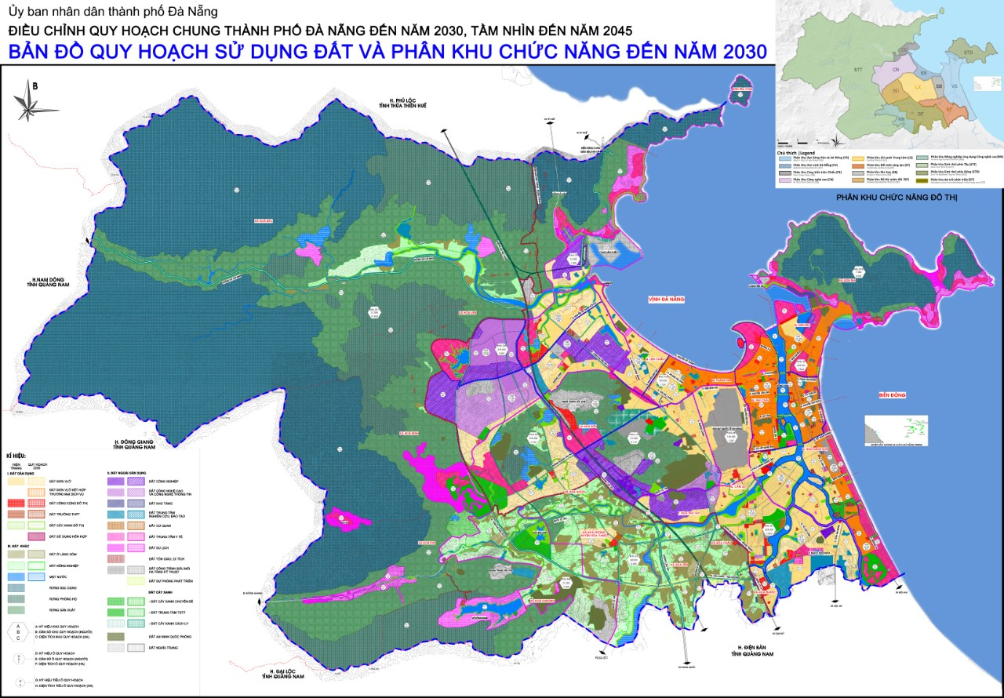
E. 03 NEW INDUSTRIAL ZONES
HOA NINH IZ (PHU MY 3 DA NANG IP)
(Hoa Ninh, Hoa Vang, Da Nang)
- Investor: Thanh Binh Phu My Ltd Co.;
- Total capital: 6,203 billion VND (240.5 million USD) (currency rate: April 2025);
- Under construction;
- Total area: 400 ha
HOA NHON IZ
(Hoa Nhon, Hoa Vang, Da Nang)
- Under procedure of investor selection;
- Total capital: Around 2,500 billion VND (96.9 million USD) (currency rate: April 2025);
- Total area: 225.3 ha.
HOA CAM – PHASE 2 IZ
(Hoa Tho Tay, Cam Le, Da Nang)
- Under bidding procedure of investor selection;
- Total capital: Around 2,176 billion VND (84.3 million USD) (currency rate: April 2025)
- Total area: 120.019 ha
(Projected location for location no.9 Da Nang Free Trade Zone)
According to Decision No. 359/QD-TTg dated March 15, 2021 issued by the Prime Minister - Approval on the the general planning adjustment for Da Nang until 2030, with a vision to 2045

Slide 18
APPENDIX I
LIST OF HI-TECH PRIORITIZED FOR DEVELOPMENT INVESTMENT
No | Hi-tech | No | Hi-tech
1 | Artificial intelligence technology. | 11 | Bioinformatics technology.
2 | Internet of Things (IoT) technology. | 12 | Geoinformatics, applying in hydro-meteorological systems, oil and gas exploration and extraction, agriculture.
3 | Big data and big data processing technology. | 13 | Technology for designing, integrating and optimizing telecommunications networks and systems in the national telecommunications infrastructure.
4 | Blockchain technology. | 14 | Technology for designing and constructing rental information systems.
5 | Virtualization technology, cloud computing, grid computing, edge computing, fog computing. | 15 | Technology for integrating systems of telecommunications technology and information technology.
6 | Quantum technology. | 16 | BPO, KPO, ITO technology; certification of digital signatures; content creation automation; software testing automation.
7 | Advanced cyber security and information confidentiality technology. | 17 | Aviation, space and remote sensing technology.
8 | Digital twin technology. | 18 | Technology for designing and manufacturing micro and nano satellites.
9 | Virtual reality, augmented reality, and mixed reality | 19 | Next-generation network technology (4G, 5G, 6G, NG-PON, SDN/NFV, SD-RAN, SD-WAN, LPWAN, IO-Link wireless, Network slicing, new generation optical network).
10 | Building Information Model (BIM) technology. | 20 | Cognitive radio technology.

Slide 19
LIST OF HIGH TECHNOLOGIES PRIORITIZED FOR DEVELOPMENT INVESTMENT
No | Hi-tech | No | Hi-tech
21 | New-generation television technology: encoding and decoding new-generation signals (H.265/HEVC, H.266/VVC); encapsulating and transmitting signals on the Internet platform, via next-generation telecommunications networks (4G, 5G, 6G); hybrid television (HbbTV); interactive television. | 31 | Intelligent human-machine interaction technology.
22 | Technology for designing and manufacturing components, integrated electronic circuit (IC), flexible electronics (PE). | 32 | Hydro-sound technology.
23 | Technology for designing and manufacturing high-resolution monitors. | 33 | Carbon capture and storage technology.
24 | Technology for manufacturing embedded computers, servers and high-performance computing systems. | 34 | Photonics and light technologies.
25 | Technology for developing operating systems for specialized computers and new generation of mobile devices. | 35 | Photovoltaics technology.
26 | Technology for designing and manufacturing new generation intelligent terminal devices. | 36 | Hydrogen energy technology.
27 | Technology for designing and manufacturing smart antennas, phase array antennas in frequency bands. | 37 | Power microgenneration technology
28 | Technology for designing and manufacturing radar cross-ground. | 38 | Non-traditional Manufacturing (NTM) technology using ultrasound, spark, electrochemical and electrochemical, plasma, high pressure water jet, laser
29 | Technology for designing and manufacturing equipment, software, solutions, platforms, services for digital government, digital economy, digital society, digital transformation in priority fields. | 39 | Technology for surface treatment and welding in special environments.
30 | Technology for designing and building simulation systems for equipment and means of transport; Plant simulation. | 40 | Advanced forging and stamping technologies to create billets for mechanical products.

Slide 20
LIST OF HIGH TECHNOLOGIES PRIORITIZED FOR DEVELOPMENT INVESTMENT
No | Hi-tech | No | Hi-tech
41 | Advanced 3D printing technology. | 48 | Precision agriculture.
42 | New-generation drilling technology for oil and gas exploration. | 49 | Technology for designing and manufacturing control devices and power electronics converters for: renewable energy generating stations, intelligent power transmission; chemical industry and ore routes; electric vehicles; industrial electric drive systems; advanced civil electronic equipment; health; construction and agriculture.
43 | Advanced oil, gas exploration and recovery. | 50 | Technology for designing and manufacturing advanced actuators, controllers, automatic monitoring and diagnostics for synchronous equipment systems in factories.
44 | Advanced energy storage technologies. | 51 | Technology for designing and manufacturing high-performance electric machines: transformers 500kV and above, transformers GIS (Gas insulated Substation), digital transformers.
45 | Advanced wind turbine technologies. | 52 | Technology for designing, manufacturing and integrating advanced robots, self-propelled equipment.
46 | Power generation technologies using tides, waves, and geothermal heat; high energy density gas fuel storage; high-performance, large capacity renewable energy storage; fuel cells; Lithium battery with high performance, large capacity, longevity, safety and environmental friendliness; energy storage with super capacitors. | 53 | Technology for designing and manufacturing new-generation high-precision numerical control (CNC) machines.
47 | Flexible manufacturing (FM), computer integrated manufacturing (CIM), intelligent manufacturing system (IMS). | 54 | Technology for designing and manufacturing advanced moulds with high precision and quality.

Slide 21
LIST OF HIGH TECHNOLOGIES PRIORITIZED FOR DEVELOPMENT INVESTMENT
No | Hi-tech | No | Hi-tech
55 | Technology for designing, manufacturing, assembling and launching self-lifting rigs, semi-submersible drilling rigs for oil and gas exploitation and super-long and super-weight structures serving the oil and gas industry; specialized lifting equipment with large loads. | 62 | Technology for designing and manufacturing advanced measuring equipment and devices: Contactless, non-destructive and non-scattered measuring devices; LiDAR, inertial navigation system (INS) measuring equipment, high precision electronic compass; profile projectors; oscilloscope, spectrum analyzer, digital radiation meter.
56 | Technology for designing and building large-sized ships and ships with complex properties. | 63 | Technology for designing and manufacturing advanced optical equipment systems: complex optical microscope; high-quality lenses, prisms, and contact lenses; high-powered laser-generating equipment (except laser diode); dedicated digital camera; new generation camera module.
57 | Technology for designing and manufacturing equipment and rails system for cable-free elevators and cable-free elevators for construction. | 64 | Technology for designing and manufacturing intelligent systems and equipment for diagnosis, monitoring, treatment and health care of human.
58 | Technology for designing and manufacturing new-generation agricultural machinery: new-generation cultivation, tending, harvesting and post-harvest machines; industrial scale food processing and storage equipment systems. | 65 | Technology for designing and manufacturing micro-electromechanical systems (MEMS), nano-electromechanical systems (NEMS), biological sensors, intelligent sensors and lab-on-a-chip systems (LOC).
59 | Technology for designing and manufacturing intelligent education and training systems and equipment. | 66 | Synthetic biology, Molecular biology.
60 | Technology for designing and manufacturing intelligent education and training systems and equipment. | 67 | Advanced biofuels; advanced biofuel production.
61 | Technology for manufacturing automatic environmental pollution monitoring systems. | 68 | New generation microbiological technology.

Slide 22
LIST OF HIGH TECHNOLOGIES PRIORITIZED FOR DEVELOPMENT INVESTMENT
No | Hi-tech | No | Hi-tech
69 | Industrial scale landless farming technology. | 79 | Molecular analysis and diagnosis.
70 | New generation technologies in processing, processing and preserving agricultural products. | 80 | Technology for separating and extracting super clean active pharmaceutical ingredients.
71 | Neurotechnologies | 81 | Technology for producing lyophilized tablets, controlled release tablets, lidose-applied capsules, epidemic drugs.
72 | Regenerative medicine and tissue engineering. | 82 | Technology for manufacturing or producing monoclonal antibodies, proteins, recombinant enzymes.
73 | Nuclear technology, radiation technology in industry, agriculture, health. | 83 | Technology for manufacturing antibacterial and antiviral equipment and materials for medical use.
74 | Technology for treating hazardous medical solid waste by sterilization of low temperature, microwave, plasma. | 84 | Technology for preparing and manufacturing new generation vaccines, medical bio-products and diagnostic bio-products.
75 | Next generation DNA sequencing technologies. | 85 | Technology for manufacturing and producing international standard microbiological preparations.
76 | Stem cell technology used in tissue, organ regeneration, disease treatment; technology to treat diseases with immune cells. | 86 | Technology for manufacturing new-generation international-standard fertilizers, plant protection drugs, plant-growth regulators, reproduction hormone products for fishery.
77 | Technology of multiplication and high quality tissue culture on an industrial scale. | 87 | Extraction technology for manufacturing super-clean materials on an industrial scale.
78 | OMICS technology (Genomics, transciptomics, proteomics, metabolomics, metanenomics). | 88 | Upcycling polymers.

Slide 23
LIST OF HIGH TECHNOLOGIES PRIORITIZED FOR DEVELOPMENT INVESTMENT
No | Hi-tech | No | Hi-tech
89 | Catalytic and adsorption materials technology. | 95 | High quality pre-cast non-metallic reinforced concrete technology.
90 | Technology for physical deposition from vapor phase (PVD) and chemical vapor deposition (CVD). | 96 | Technology for 500-kA aluminum electrolysis.
91 | Advanced nanomaterial technology, nano-coating. | 97 | Advanced materials manufacturing technology: materials for manufacturing micro-electromechanical components and smart sensors; semiconductor, optoelectronic and photonic materials; invisible materials; self healing materials; magnetic materials; advanced 3D printing materials; super durable, super light materials; materials, equipment in constant and permanent contact with fluid, bone, tissue, or blood; biomedical materials; advanced polymer materials and high-quality polymeric substrates; polymer materials that are self-biodegradable and environmentally friendly; high-tech ceramic and ceramic materials; high-performance fiber materials, special fiberglass, carbon fiber; functional materials.
92 | Nanotechnology in manufacturing. | 98 | Technology for manufacturing high-class and environment-friendly special-use paints.
93 | Technologies for the production of pure metals, special alloys. | 99 | Technology for manufacturing high-grade technical rubber, specialized synthetic rubber for machine manufacturing, power, electronics, security and national defense.
94 | Technology for inhibiting metal corrosion in marine environments and special industrial processes.

Slide 24
APPENDIX II
LIST OF HI-TECH PRODUCTS ENCOURAGED FOR DEVELOPMENT
No | Hi-tech products | No | Hi-tech products
1 | Systems, equipment, software, identity analysis, prediction and control based on artificial intelligence. | 10 | Service of designing and optimizing telecommunications networks and systems in the national telecommunications infrastructure.
2 | Equipment, modules, software, platforms, loT integration solutions and IoT platform services. | 11 | Service of consulting, designing and leasing information technology systems.
3 | Equipment, software, solutions, and services of blockchain technology. | 12 | Service of integrating and managing systems of telecommunications technology and information technology.
4 | Equipment, software, solutions, virtualization services, system integration services, cloud computing, edge computing, fog computing. | 13 | Services of BPO, KPO, ITO; certification of digital signatures; content creation automation; software testing automation.
5 | Advanced equipment, software, solutions and services to ensure network security and safety and information confidentiality. | 14 | Software, equipment, solutions, and services of software testing automation.
6 | Smartcards and smartcard readers. | 15 | Satellites, small satellites, micro satellites and satellite equipment; satellite equipment and transceiver station; flying equipment; flight control system.
7 | Devices, software, solutions, and services in virtual reality, augmented reality, and mixed reality. | 16 | Global positioning system and equipment.
8 | Building Information Model (BIM). | 17 | Next-generation network technology (4G, 5G, 6G, NG-PON, SDN/NFV, SD-RAN, SD-WAN, LPWAN, IO-Link wireless, Network slicing, new generation optical network).
9 | Biomedical processing software, information database. | 18 | Cognitive radio equipment, software and solutions.

Slide 25
No | Hi-tech products | TT | Hi-tech products
19 | New-generation signal encoding and decoding equipment, modules and software (H.265/HEVC, H.266/VVC); equipment for encapsulating and transmitting signals on the Internet platform, via next-generation telecommunications networks (4G, 5G, 6G); hybrid television equipment and systems (HbbTV), interactive television. | 29 | Equipment, software, solutions, platforms, services for digital government, digital economy, digital society, digital transformation in priority fields.
20 | IC design and IP core. | 30 | Non-traditional Manufacturing (NTM) equipment and solutions using ultrasound, spark, electrochemical and electrochemical, plasma, high pressure water jet, laser.
21 | Components, integrated electronic circuit (IC); flexible electronic circuit (PE) products. | 31 | Equipment and solutions for surface treatment and welding in special environments.
22 | High-resolution displays. | 32 | Advanced 3D printing equipment, software and solutions.
23 | Embedded computers, servers and high-performance computing systems. | 33 | New generation drilling systems and equipment in oil and gas exploration.
24 | Operating systems for specialized computers and new generation of mobile devices. | 34 | Power generation systems using tides, waves, and geothermal heat.
25 | New-generation smart terminal devices. | 35 | High efficiency and environmental friendly photovoltaic (PV) panels.
26 | Smart antennas, phase array antennas in frequency bands. | 36 | High energy density gas fuel storage systems and equipment.
27 | Ground-penetrating radar equipment. | 37 | High capacity, large capacity renewable energy storage systems and equipment.
28 | Equipment, software, solutions, platforms, services for digital government, digital economy, digital society, digital transformation in priority fields. | 38 | Fuel cells; high-performance, large capacity, long-life, safe and environmentally friendly battery and Lithium battery pack; power storage using super capacitors.
LIST OF HI-TECH PRODUCTS ENCOURAGED FOR DEVELOPMENT

Slide 26
LIST OF HI-TECH PRODUCTS ENCOURAGED FOR DEVELOPMENT
No | Hi-tech products | No | Hi-tech products
39 | Advanced electrolyte and electrolyte membrane for fuel cells. | 49 | New generation high-precision computer numerical control (CNC) systems, machine tools, and equipment.
40 | Optimal control system, structure and mechanism for efficient fuel supply, oxygen and heat management for fuel cells. | 50 | Advanced moulds with high precision and quality.
41 | Equipment, lines, systems, software, manufacturing solutions for flexible manufacturing system (FMS), computer integrated manufacturing (CIM) and intelligent manufacturing system (IMS). | 51 | Self-lifting rigs, semi-submersible drilling rigs for oil and gas exploitation and super-long and super-weight structures serving the oil and gas industry; specialized lifting equipment in large loads.
42 | Digital protection equipment, equipment to ensure the quality of electricity in the power system. | 52 | Large ships, ships with complex features.
43 | Control equipment, high-performance electronic conversion equipment for: renewable energy generating stations, intelligent power transmission; chemical industry and ore routes; electric vehicles; industrial electric drive systems; advanced civil electronic equipment; health; construction and agriculture. | 53 | Equipment and rails system for cable-free elevators and cable-free elevators for construction.
44 | High-performance wireless charging stations and equipment. | 54 | New-generation cultivating, tending, harvest and post-harvest machinery.
45 | Advanced actuators, controllers, automatic monitoring and diagnostics for synchronous equipment systems in factories. | 55 | Systems of equipment for industrial-scale food processing and preservation.
46 | High-performance electrical machines: transformers 500 kV or higher, transformers GIS (Gas Insulated Substation), digital transformers. | 56 | Intelligent education and training systems and equipment.
47 | Advanced robot, advanced robot integration system. | 57 | Equipment for smart grid.
48 | Self-propelled equipment. | 58 | Automatic environmental pollution monitoring systems.

Slide 27
LIST OF HI-TECH PRODUCTS ENCOURAGED FOR DEVELOPMENT
No | Hi-tech products | No | Hi-tech products
59 | Contactless, non-destructive and non-scattered measuring devices. | 71 | New-generation DNA sequencing products and solutions.
60 | LiDAR, inertial navigation system (INS) measuring equipment, high precision electronic compass. | 72 | Cells, tissues and replacement organs made up of stem cells; treatment with stem cells and immune cells.
61 | Profile projectors. | 73 | High quality products from cell multiplication and culture on an industrial scale.
62 | Digital oscilloscopes, spectral analyzers and digital radiation meters. | 74 | Systems and equipment for molecular analysis and diagnosis.
63 | Complex optical microscopes. | 75 | Super clean active pharmaceutical ingredients.
64 | High-quality lens, prisms, contact lenses. | 76 | Lyophilized tablets, controlled release tablets, lidose-applied capsules, epidemic drugs.
65 | Large-capacity laser machines (except laser diodes). | 77 | Monoclonal antibodies, proteins, recombinant enzymes.
66 | Dedicated digital camera, new generation camera module. | 78 | Antibacterial and antiviral equipment and materials for medical use.
67 | Intelligent systems and equipment for diagnosis, monitoring, treatment and health care of human. | 79 | New generation vaccines, medical bio-products and diagnostic bio-products.
68 | Micro-electromechanical systems (MEMS), nano-electromechanical systems (NEMS), biological sensors, intelligent sensors and lab-on-a-chip systems (LOC). | 80 | International standard microbiological preparations.
69 | Advanced biofuel preparations. | 81 | International-standard new-generation fertilizers and plant protection drugs.
70 | Industrial, agricultural and medical equipment using nuclear technology and radiation technology. | 82 | New-generation international-standard plant-growth regulators, reproduction hormone products for fishery.

Slide 28
LIST OF HI-TECH PRODUCTS ENCOURAGED FOR DEVELOPMENT
No | Hi-tech products | No | Hi-tech products
83 | High-purity materials manufactured by extraction technology on an industrial scale. | 96 | Self healing materials.
84 | Upcycling polymers. | 97 | Advanced magnetic materials.
85 | Catalytic, absorbent materials. | 98 | Advanced 3D printing materials, environmentally friendly.
86 | Products covered with membranes manufactured by physical vapor deposition (PVD) and chemical vapor deposition (CVD). | 99 | Super-durable, ultra-light and environment-friendly materials or materials for use in harsh environments.
87 | Advanced nano-materials, nano-coating. | 100 | Materials, equipment in constant and permanent contact with fluid, bone, tissue, or blood.
88 | Nanotechnology products and equipment. | 101 | Advanced polymer materials and high-quality polymeric substrates used in harsh environments, resistant to tropical climates.
89 | Pure metals, special alloys with high strength. | 102 | Bioplastics, biodegradable polymers from renewable and biological materials.
90 | Systems and materials that inhibit metal corrosion under special climatic conditions and industrial processes. | 103 | Ceramic materials, technical ceramics for electric, electronic and machine building industries.
91 | High quality prefabricated non-metallic reinforced concrete. | 104 | High performance fiber, special glass fiber, carbon fiber.
92 | Aluminum metal produced by electrolysis technology with current of 500 kA. | 105 | Functional materials.
93 | Materials for making micro-electromechanical components and smart sensors. | 106 | Environment-friendly high-class special-use paints.
94 | Semiconductor, optoelectronic and photonic materials. | 107 | Special-use technical rubber and synthetic rubber materials for machine building, electricity industry, electronics, national defense and security.
95 | Invisible materials.

Slide 29
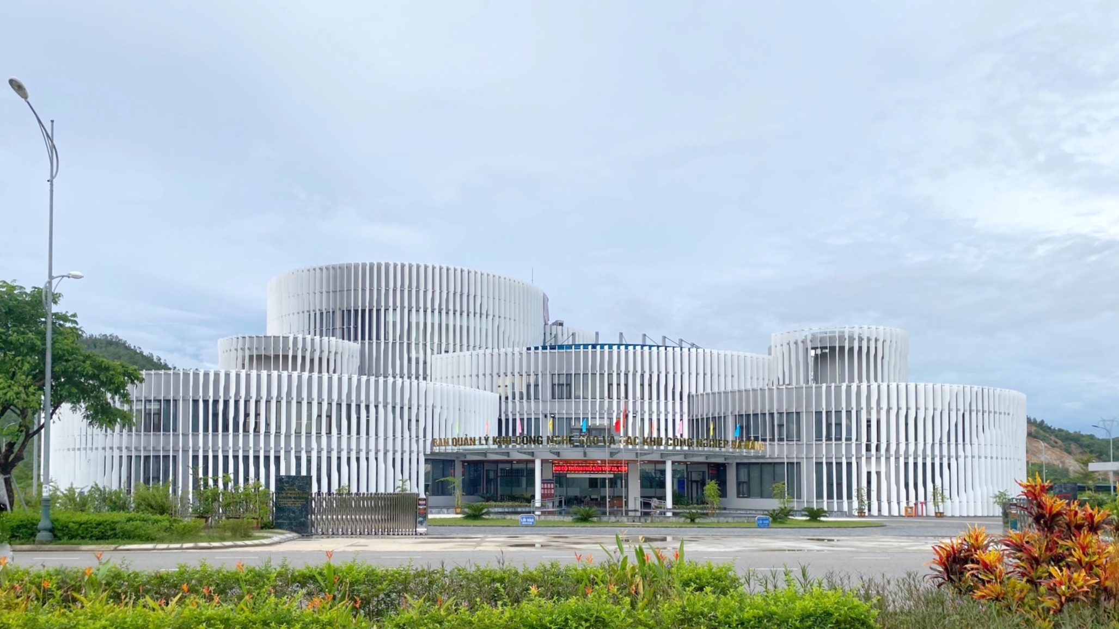
Da Nang Hi-tech Park and Industrial Zones Authority Headquarter
Central Road, Da Nang Hi-tech Park, Hoa Lien commune, Hoa Vang rural district, Da Nang

Slide 30
DA NANG HI-TECH PARK AND INDUSTRIAL ZONES AUTHORITY
Address: Lot A17, Central Road, Da Nang Hi-tech Park, Hoa Lien commune,
Hoa Vang rural district, Da Nang
Tel: (84) 236 3666117 | Website: dseza.danang.gov.vn

